Slide 1
Pizza Sales Report

Slide 2
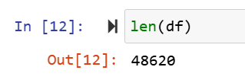

Total Number of orders
The Total number of orders are 48620

Slide 3
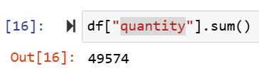

Total Pizzas Sold
The Total Number of pizzas sold are 49574.

Slide 4


Total Revenue Generated
The Total Revenue generated is 817860.05 $.

Slide 5
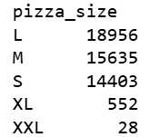
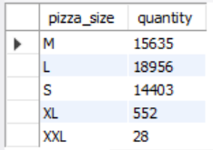
Size wise Pizzas sold
Large size pizzas are ordered more which are 18956.

Slide 6
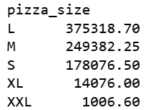
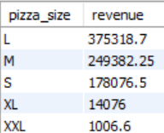
Size wise Revenue
Large size pizzas generate maximum revenue 375318 $.

Slide 7
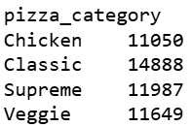
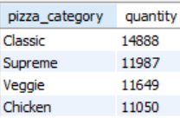
Category wise pizzas sold
Classic pizzas are ordered more which are 14888.

Slide 8
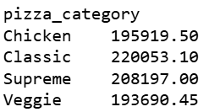
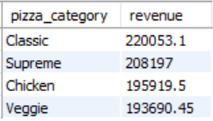
Category wise revenue
Classic pizzas generate maximum revenue 220053.1 $.

Slide 9
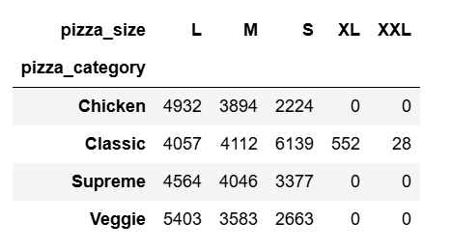
Pizzas sold according to size in each category

Slide 10
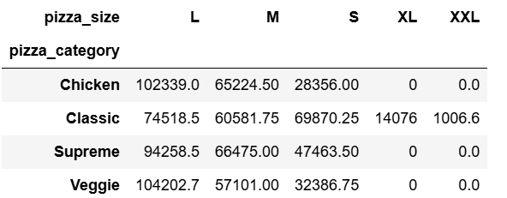
Revenue generated by pizzas size in each category

Slide 11
Final Analysis
The Total Revenue generated is 817860.05 $.
Large size pizzas are ordered more which are 18956 and generate maximum revenue which is 375318 $. It indicates that most of the customer are either coming in the pair or with family and friends.
In Chicken, Supreme and Veggie Category , XL and XXL size pizzas are not available.
If we talk about the category wise Classic pizzas are sold more as compared to other categories.
If we check category and size wise, S size pizzas from classic category are sold maximum but the highest revenue is generated by L size pizza from Veggie Category.

